Slide 1


AI编译器-系列之PyTorch
TorchDynamo
ZOMI

Slide 2
Talk Overview
PyTroch 2.0 新特性
2.0 新特性回顾
PyTorch 2.0 安装与新特性使用
PyTorch 2.0 对厂商的启发和思考
TorchDynamo 解读
TorchDynamo 特性
TorchDynamo 实现方案
AOTAutograd 解读
AOTAutograd 效果
AOTAutograd 实现方案
TorchInductor 新特性
Triton 使用解读
Triton 深度剖析

Slide 3
Talk Overview
TorchDynamo 解读
PyTorch 获取计算图的方式
PyTorch JIT Script 原理
PyTorch FX 原理
PyTorch Lazy Tensor 原理
TorchDynamo 原理

Slide 4
图模式的
尝试回顾

Slide 5
Purpose

Slide 6
Comparation
特性 | 内容 | 适用场景 | 技术方式
TorchScript | TorchScript 的主要用途是进行模型部署，需要记录生成一个便于推理优化的 IR，对计算图的编辑通常都是面向性能提升等等，不会给模型本身添加新的功能。 | 推理和部署静态图优化 | AST + Trace
Torch FX | FX 的主要用途是进行python->python的翻译，它的 IR 中节点类型更简单，比如函数调用、属性提取等等，这样的 IR 学习成本更低更容易编辑。使用 FX 来编辑图通常是为了实现某种特定功能，比如给模型插入量化节点等，避免手动编辑网络造成的重复劳动。 | 修改正向图 | Trace
LazyTensor | 采用 tensor 不被用户观察那么就可以缓存计算指令的方式，隐式构图+优化，用户不用标记构图的代码范围，对用户的代码限制小，是一种能优化就优化、不能优化也能执行的思路，偏向于易用性 | 针对NPU子图编译优化 | Trace
TorchDynamo | TorchDynamo 是 PyTorch 新实验的 JIT 编译接口，支持使用 Python 在运行时修改动态执行逻辑，修改的时机是 CPython 的 ByteCode 执行前。思想类似 DynamoRIO 项目，DynamoRIO 可以动态的修改 x86 机器码。 | 动静统一 + 编译优化 | Python 解析修改

Slide 7
TorchDynamo
原理

Slide 8
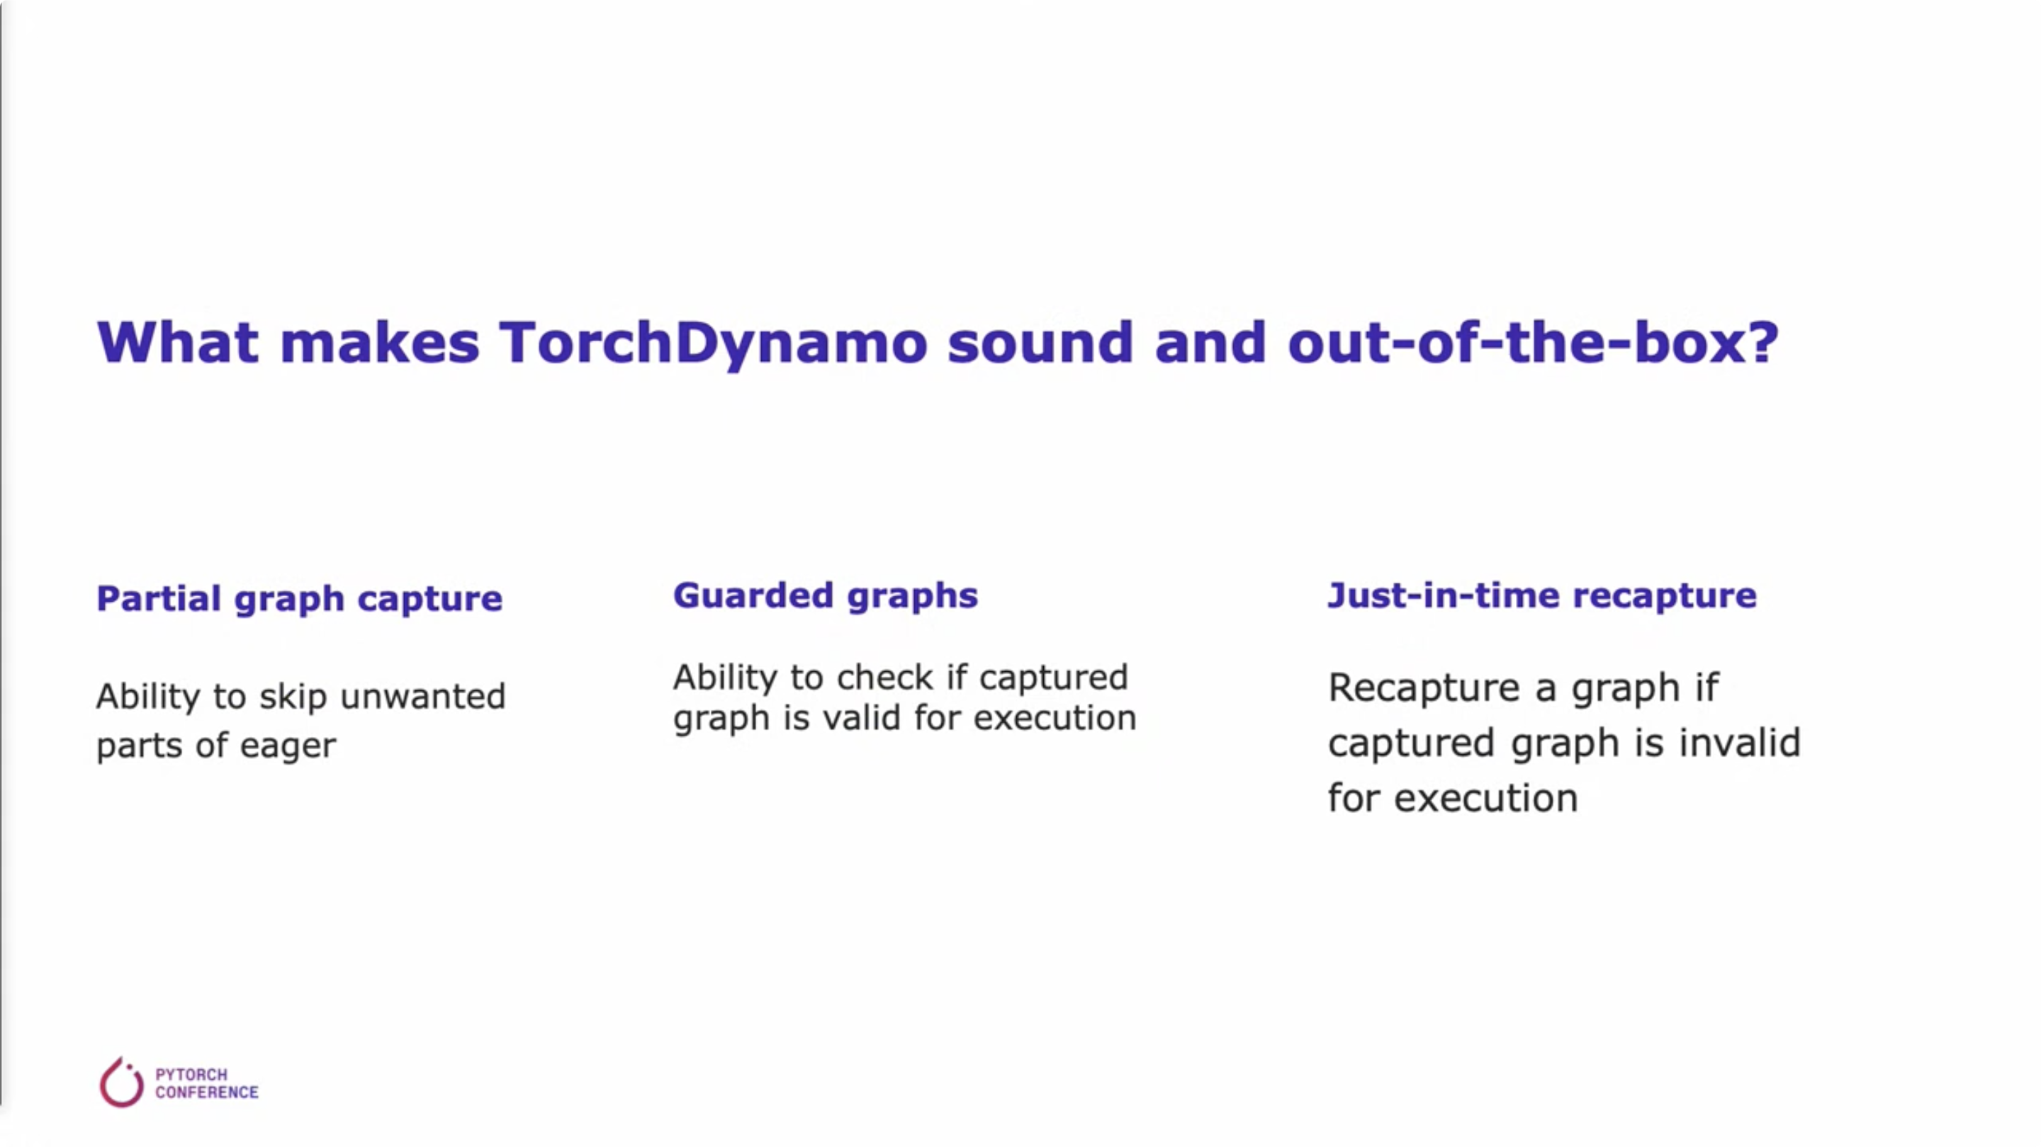

Slide 9
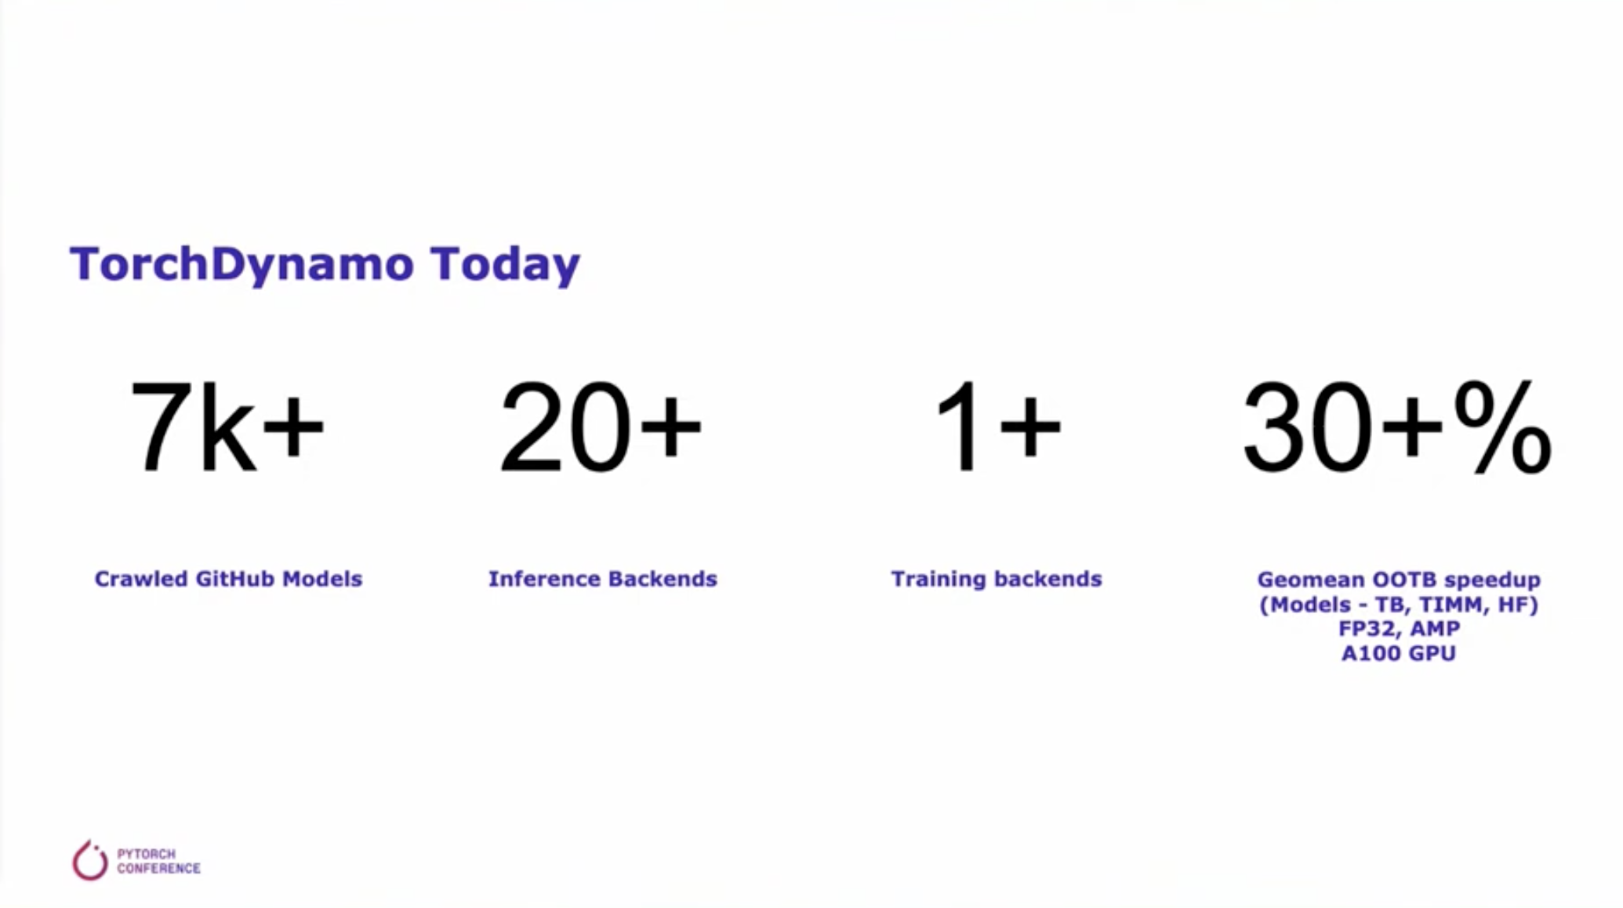

Slide 10
PyTorch 编译模式

Slide 11
PyTorch 编译模式

Slide 12
Python 执行机制
CPython： CPython 混合了编译和解释功能，将Python源代码首先被编译成一系列中间字节码，然后由CPython虚拟机内部 while 循环不断匹配字节码并执行对应字节码指令 case 分支内部的多条C函数。

Slide 13
Python 执行机制： PyFrameObject 和 PyCodeObject
每一个PyFrameObject对象都维护着一个PyCodeObject对象，每一个PyFrameObject对象和Python源码中的一段code都是对应的。
PyCodeObject对象包含了程序中的静态信息，然而有一点PyCodeObject对象没有包含，那就是关于程序运行时的动态信息——执行环境。
在Python真正执行的时候，它的虚拟机实际上面对的并不是一个PyCodeObject对象，而是另外一个对象——PyFrameObject。
在Python实际执行的过程中，会产生很多PyFrameObject对象，而这些对象会被链接起来，形成一条执行环境链表。
PyFrameObject对象是对x86机器上单个栈帧活动的模拟，既然在x86的单个栈帧中，包含了计算所需的内存空间、寄存器地址指针、运行栈顺序、执行环境等信息。

Slide 14
Python 执行机制
在 CPython 解释器 Interpreter 中运行Python程序。虽然Python代码被转换为字节码 byteCode，但是这个字节码并不在CPU上运行，而是由程序本身执行。这个解释器程序的核心是 _PyEval_EvalFrameDefault。

Slide 15
Dynamo 实现原理
在 Python 解释器自动把动态 ByteCode 进行捕抓，转换成为为 TorchFX IR。

Slide 16
Dynamo 实现原理
TorchDynamo is an early experiment that radically rethinks the approach for recapturing these optimization opportunities. It hooks into the frame evaluation API in CPython to dynamically modify Python bytecode right before it is executed.
This is analogous to what DynamoRIO does by dynamically modifying x86 machine code.
TorchDynamo dynamically rewrites Python bytecode in order to extract sequences of PyTorch operations into an FX Graph which is then just-in-time compiled with a user-defined compiler.
It creates FX Graph through bytecode analysis, not tracing, and is designed to generating smaller graph fragments that can be mixed with Python execution.

Slide 17
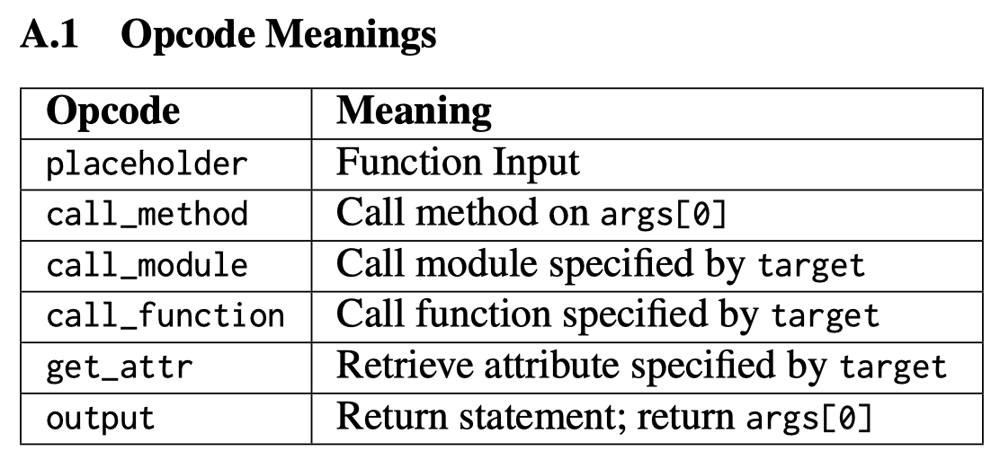
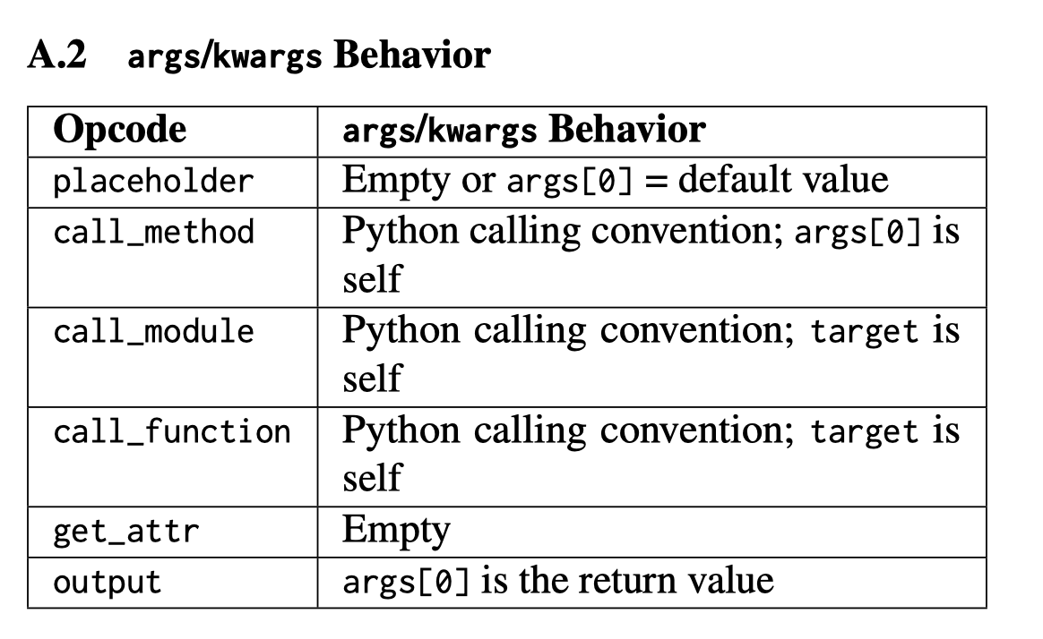
TORCH.FX NODE SEMANTICS
torch.fx represents programs in a DAG-based IR, which contains a linear series of Node objects representing operations. Nodes have a string opcode, describing what type of operation the Node represents. Nodes have an associated target, which is the call target for call nodes (call_module, call_function, and call_method).

Slide 18
TORCH.FX IR
placeholder represents a function input. The name attribute specifies the name this value will take on. target is similarly the name of the argument. args holds either: 1) nothing, or 2) a single argument denoting the default parameter of the function input. kwargs is don’t-care. Placeholders correspond to the function parameters (e.g. x) in the graph printout.
get_attr retrieves a parameter from the module hierarchy. name is similarly the name the result of the fetch is assigned to. target is the fully-qualified name of the parameter’s position in the module hierarchy. args and kwargs are don’t-care
call_function applies a free function to some values. name is similarly the name of the value to assign to. target is the function to be applied. args and kwargs represent the arguments to the function, following the Python calling convention
call_module applies a module in the module hierarchy’s forward() method to given arguments. name is as previous. target is the fully-qualified name of the module in the module hierarchy to call. args and kwargs represent the arguments to invoke the module on, including the self argument.
call_method calls a method on a value. name is as similar. target is the string name of the method to apply to the self argument. args and kwargs represent the arguments to invoke the module on, including the self argument
output contains the output of the traced function in its args[0] attribute. This corresponds to the “return” statement in the Graph printout.

Slide 19
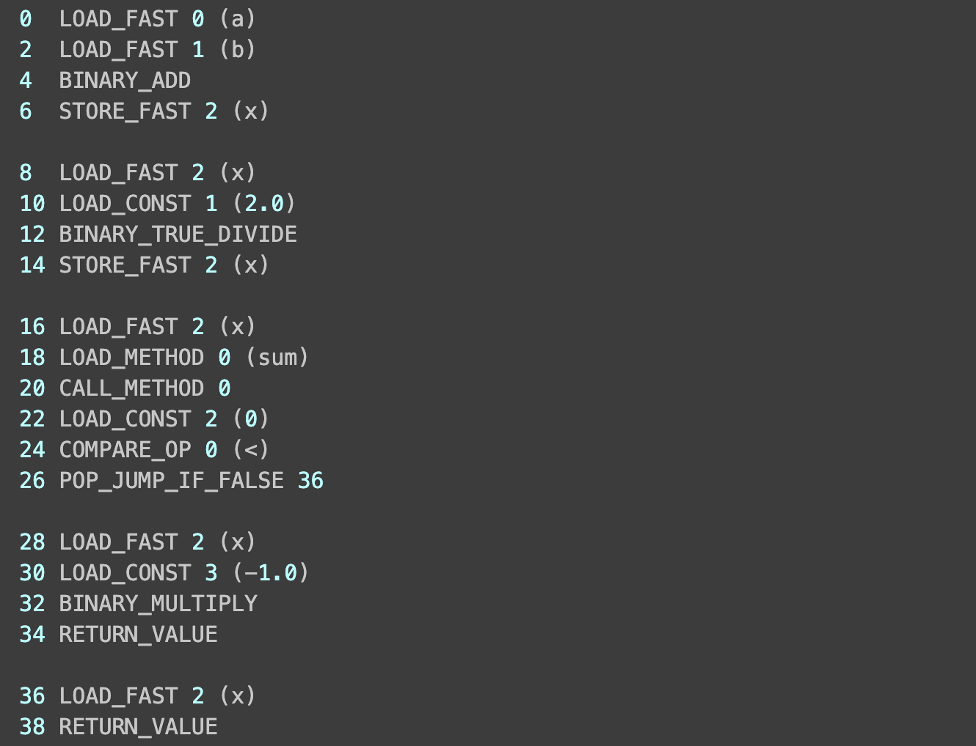
Results in the following original Python bytecode

Slide 20
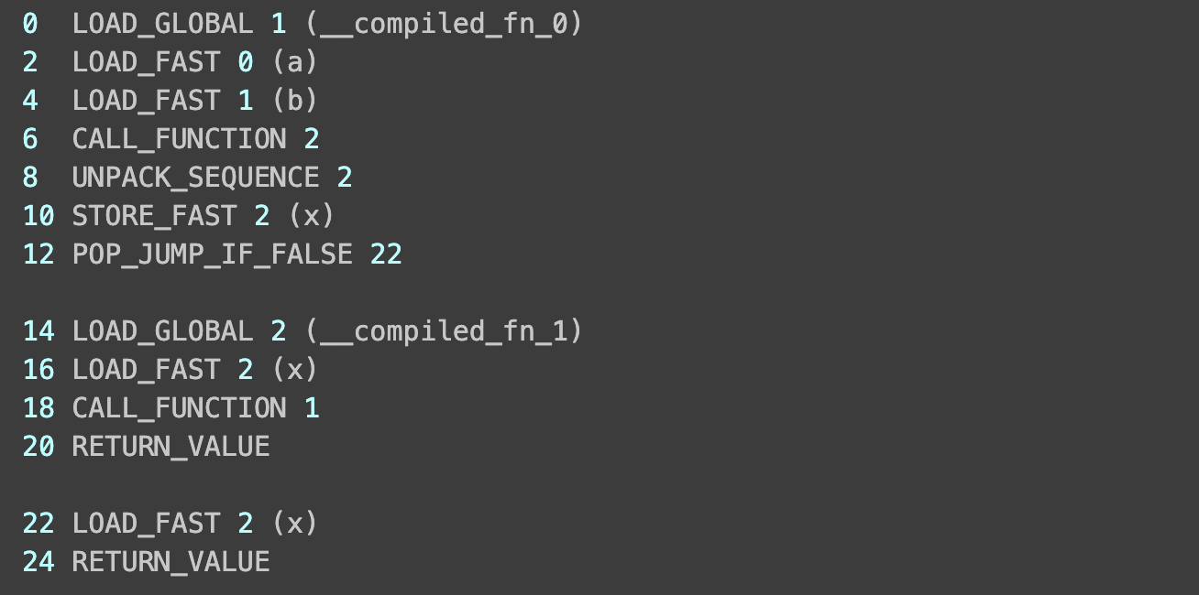
TorchDynamo dynamically rewrites that bytecode as follows

Slide 21
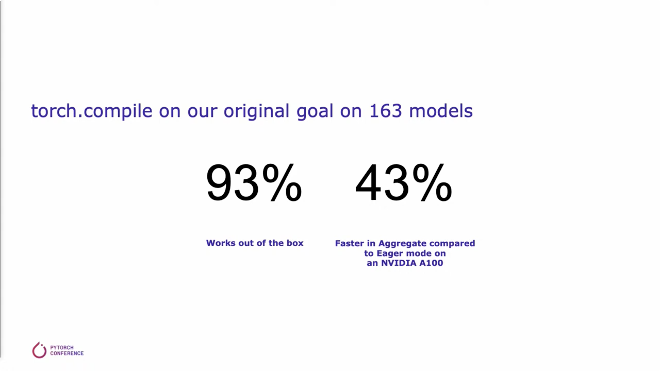

Slide 22
Dynamo Pros and Cons
This approach has many advantages:
It supports all Python because it can easily fall back to running the original bytecode. It depends on a fast eager mode in order to work properly, because the goal is to enhance eager mode rather than replace it.
It is extremely low overhead, where it is possible to remove Python overheads from the original program by intercepting things at the very top of the stack.
It does not introduce any added latency by deferring execution.

Slide 23
Inference
TorchDynamo: An Experiment in Dynamic Python Bytecode Transformation. https://ev-discuss.pytorch.org/t/torchdynamo-an-experiment-in-dynamic-python-bytecode-transformation/361
The nuances of PyTorch Graph Capture. https://dev-discuss.pytorch.org/t/the-nuances-of-pytorch-graph-capture/501
TORCHDYNAMO AND TORCHINDUCTOR TUTORIAL. https://pytorch.org/tutorials/intermediate/dynamo_tutorial.html

Slide 24
Notes:
24

